Slide 1
Software Modeling: Architecture
Chapter 5

Slide 2
Contents
What is software model?
Why modeling?
How to design a software model?
What is software architecture?
How to design an architecute?

Slide 3
1 What is software model?
Software is composed by many programs built from source code.
But how to organize the codes?
Source code
Applicatioin
Software
Tools

Slide 4
1 What is software model?
How to organize the source code?
Poor-organized codes are impossible to compile, debug and read/write by programers
C/C++ use seperate header and source files.
Java use packages and class files.
But they are all low-level ways.
Programmer should do it in application level.
Software modules
Group the source code into different modules
The way how modules are designed is software modeling.

Slide 5
1 What is software model?
Software modules
Have a unique function as a whole, and sub-functions inside, which are tightly coupled.
From the view of the user, the software modules are abstraction of software system activities.
Two ways to design software modules:
Object-Oriented
Top-Down / Traditional / Structure based analysis and design

Slide 6
2 Why modeling the software?
Software can be extremely complex. e.g.
Business software: Information System
Automation software: Robotics, Automatic product line.
Software Engineering's requirements
Make source codes easy to write, read, understood, and debug.

Slide 7
3 How to design a software model
software engineering
OO (object oriented) methods
Structure based analsis and design method

Slide 8
3 How to design a software model
Object-Oriented Methods
OO based requirements analysis
OO based system design
OO based programming
Basic concepts:
Class and Object
Methods and Attributes
Relationship

Slide 9
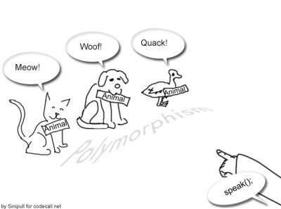
3 How to design a software model
Advanced concepts of OO
Wrap
Overide
Inheritance
Polymorphism
Interface
Virtual Class

Slide 10

OO modeling
Class Diagram
Sequence Diagram
State Diagram
see "UML" for more details

Slide 11
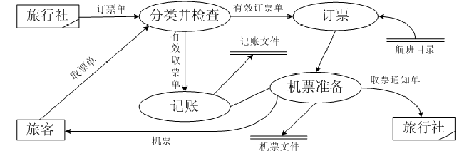
Structure based analysis and Design
Procedure based method
Data structure
Data flow diagram

Slide 12
4 What is software architecture
Software architecture is an implemented model of software
Structure of the software models
Structure has been defined and devided into different modules
Developers need only to implement modules
People who design the architecture is called architect.

Slide 13
5 How to design an Architecture
Method1: Choose from existing framework.
.NET
MFC
MVC
...
Method2: Design from scratch
Principle: High cohesion and low coupling
Feasiblity, extendability, resusability, and easy of use
Experience in programming is very important.

Slide 14
Path to be an architect
Programmer
Advanced Programmer
System Analyser
Software Architect

Slide 15



To Mechatronic software developers
Improving through practice
Always keep in mind the ARCHITECTURE.

